Slide 1




Gambling I
Produced by Dr. Mario
UNC STOR 390

Slide 2

Sports gambling 101
Bookmaker
Person/Organization Who Takes Bets and Pays Off Bets in Sports
AKA a Bookie (Individual)
AKA a Sportsbook (Organization)
AKA The Real Winner
AKA Someone Who Profits Off Stupidity
Five Online Sportsbooks for US Bettors
Bovada
5Dimes
BetOnline
GTBets
Youwager

Slide 3
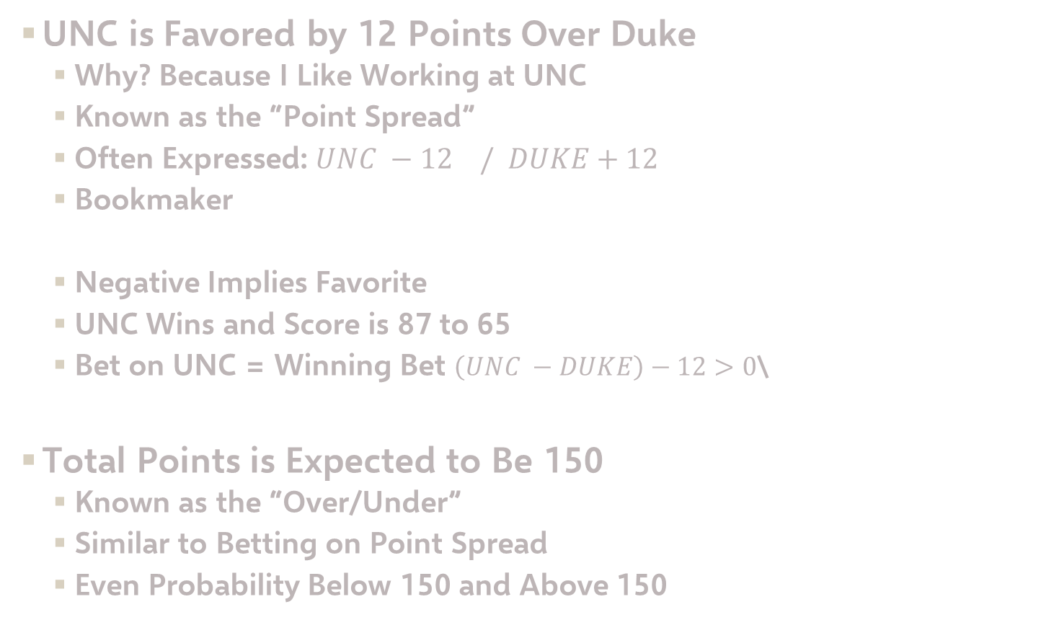
Sports gambling 101
UNC is Favored by 12 Points Over Duke
Why? Because I Like Working at UNC
Known as the “Point Spread”
Often Expressed: $UNC −12 / DUKE+12$
Bookmaker
Negative Implies Favorite
UNC Wins and Score is 87 to 65
Bet on UNC = Winning Bet $\left(UNC −DUKE\right)−12>0$\
Total Points is Expected to Be 150
Known as the “Over/Under”
Similar to Betting on Point Spread
Even Probability Below 150 and Above 150
$$P\left(UNC−DUKE>12\right)=P\left(UNC−DUKE<12\right)≈50\%$$

Slide 4
Sports gambling 101
Unit
Popular Term in Sports Betting
Measurement of the Size of Someone’s Bet
+25 Units Doesn’t Mean Anything and is Arbitrary
What is Better?
Person 1: Started with $100 and Now Has $800
Person 2: Started with $1000 and Now Has $8000
If Each Unit is $1,
Person 1 is Up 700 Units
Person 2 is Up 7000 Units
If Each Unit is 1% of Bankroll,
Person 1 is Up 700 Units
Person 2 is Up 700 Units

Slide 5
Sports gambling 101
Odds
Ratio of Probability of Winning to Probability of Losing
Fractional Representation:
10/1
1/1
1/10 or 0.1/1
American Representation:
+1000
100 or -100
-1000
Interpretation for Payout
Bet $1 to Win $10 or Bet $100 to Win $1000
Bet $1 to Win $1 or Bet $100 to Win $100
Bet $1 to Win $0.10 or Bet $1000 to Win $100

Slide 6
Sports gambling 101
Payout Odds
Bookmakers Use Odds to Payout
Suppose Team Has 50% Chance of Winning
Fair Odds is 1/1 (100 or -100)
Most Common Odds is 10/11 (-110)
Interpretation of Typical Odds
Bet $11 to Win $10 (Total=$21)
Bet $110 to Win $100
Bookmaker Makes 10% Profit on Bets
Formula: Total Amount If You Win
Formula: Total Amount If You Lose
$$Total=Base+Bet×Fractional Odds$$
$$Total=Base−Bet$$

Slide 7

Sports gambling 101
How Bettors Make Money
p = Probability Gambler Wins a Point Spread Bet
When is Expected Profit $0 If Betting $11
If Gambler Wins More Than 52.4% of Time, Gambler Wins Long Term
How Bookmakers Make Money
Vig = Bookmaker’s Mean Profit Per Dollar Bet
Suppose We Bet $11 on Bet With Odds 10/11 and Win
Suppose Bo Bets $11 on Same and Loses
Bookmaker Gets $22 and Pays $21 to Us
$$p=0.524$$
$$E\left[Profit\right]=10p−11\left(1−p\right)=0$$
$$Vig=\frac{\$1}{22}=4.5\%$$

Slide 8
Sports gambling 101
Money Line
Gamblers Don’t Only Have to Bet on Events with 50% Chance
Money Line Allows Bettor to Bet on Who Wins Outright
Money Line in 2007 NBA Finals
-450 Spurs
+325 Cavaliers
Negative Implies Favored
Interpretation
Bet $450 on Spurs and Get $100 if Spurs Win
Bet $100 on Cavaliers and Get $325 If Cavs Win
Strategy for Betting on Spurs
Want Expected Profit to Be More Than $0
p = Probability Spurs Win
Believe Spurs Have 82% Chance of Winning
$$E\left[Profit\right]=\left(100\right)×p+\left(−450\right)×\left(1−p\right)>0$$

Slide 9
Sports gambling 101
Money Line
Strategy for Betting on Spurs
Want Expected Profit to Be More Than $0
p = Probability Spurs Win
Believe Spurs Have 82% Chance of Winning or Higher
Strategy for Betting on Cavs
Want Expected Profit to Be More Than $0
Believe Spurs Have 76% Chance of Winning or Lower
$$E\left[Profit\right]=\left(100\right)×p+\left(−450\right)×\left(1−p\right)>0$$
$$E\left[Profit\right]=\left(−100\right)×p+(325)×\left(1−p\right)>0$$

Slide 10

Sports gambling 101
Arbitrage Betting Opportunity
Combination of Bets Without Risk
Consider the Following Betting Lines
Bookie 1 Offers Better Odds on Colts = Take Colts
Bookie 2 Offers Better Odds on Bears = Take Bears

Slide 11
Sports gambling 101
Arbitrage Betting Opportunity
Suppose You Bet x Dollars with Bookie 1
Suppose You Bet $100 Dollars with Bookie 2
Profit if Colts Win
Profit if Bears Win
Betting Between $122 and $125 With Bookie 1 Guarantees Win
$$\left(\frac{100}{122}\right)x−100>0 if x>\$122$$
$$125−x>0 if x<\$125$$

Slide 12
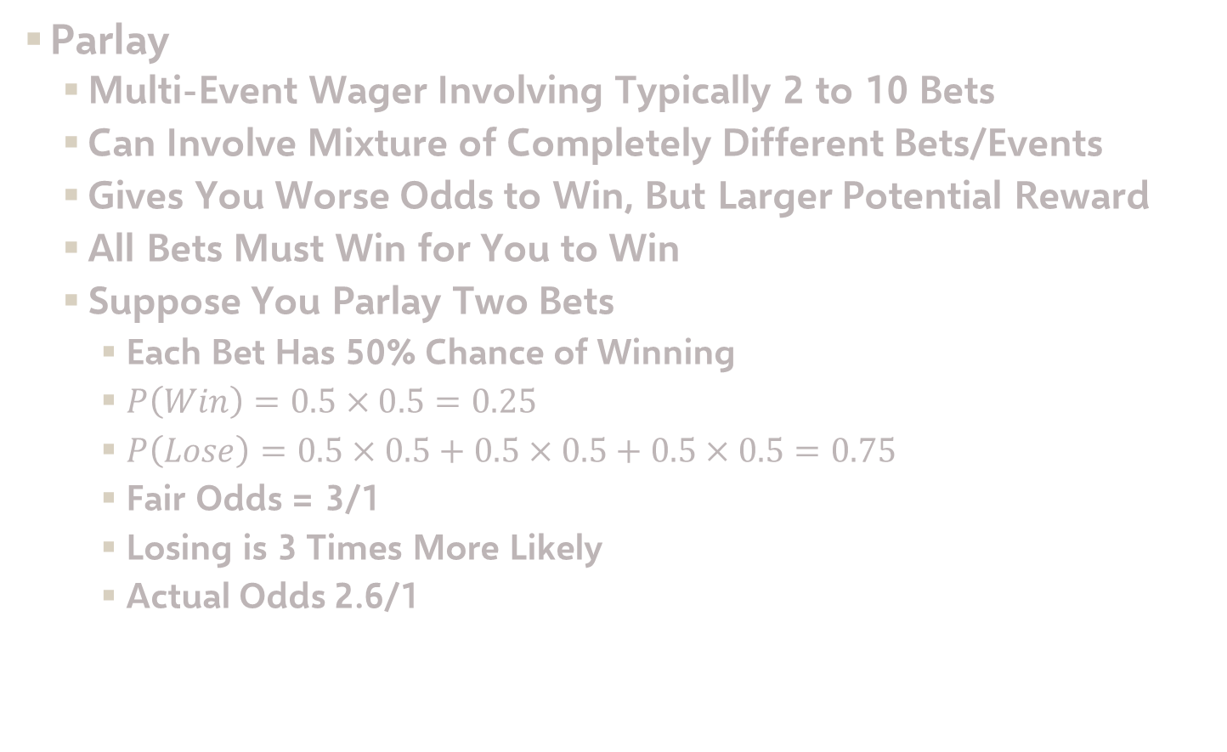
Sports gambling 101
Parlay
Multi-Event Wager Involving Typically 2 to 10 Bets
Can Involve Mixture of Completely Different Bets/Events
Gives You Worse Odds to Win, But Larger Potential Reward
All Bets Must Win for You to Win
Suppose You Parlay Two Bets
Each Bet Has 50% Chance of Winning
$P\left(Win\right)=0.5×0.5=0.25$
$P\left(Lose\right)=0.5×0.5+0.5×0.5+0.5×0.5=0.75$
Fair Odds = 3/1
Losing is 3 Times More Likely
Actual Odds 2.6/1

Slide 13
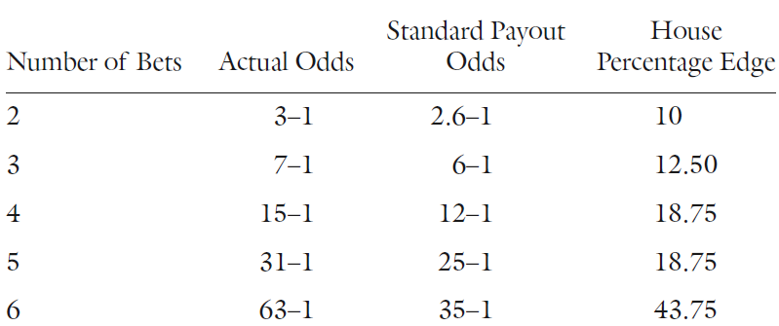
Sports gambling 101
Parlay
House Edge for Parlay if Betting $100
For Fair Odds, Expected Profit is $0
For 2.6/1 Odds, Expected Profit is …
House Expected to Win $10
Percent of Bet = +10%
Table of Payoffs
$$E\left[Profit\right]=0.25×260+0.75×100=−10$$

Slide 14
Sports gambling 101
Parlay
Correlated Events in Parlays
Bet 1: Tom Brady Throws Touchdown to Gronkowski
Bet 2: Tom Brady Throw 3 Touchdowns
Notice the Following Conditional Probability
Fair Odds If Events are Independent: 3/1
Probability of Winning Parlay
Fair Odds for This Parlay: 1.22/1
Suppose You Bet $100 and Win
You Should Win $122
You Will Win $300
$$P\left(Win Bet 1\right)=0.5=50\%$$
$$P\left(Win Bet 2\right)=0.5=50\%$$
$$P\left(Win Bet 1 | Win Bet 2\right)=90\%$$
$$P\left(Win Parlay\right)=P\left(Win Bet 2\right)×P(Win Bet 1|Win Bet 2)=45\%$$

Slide 15
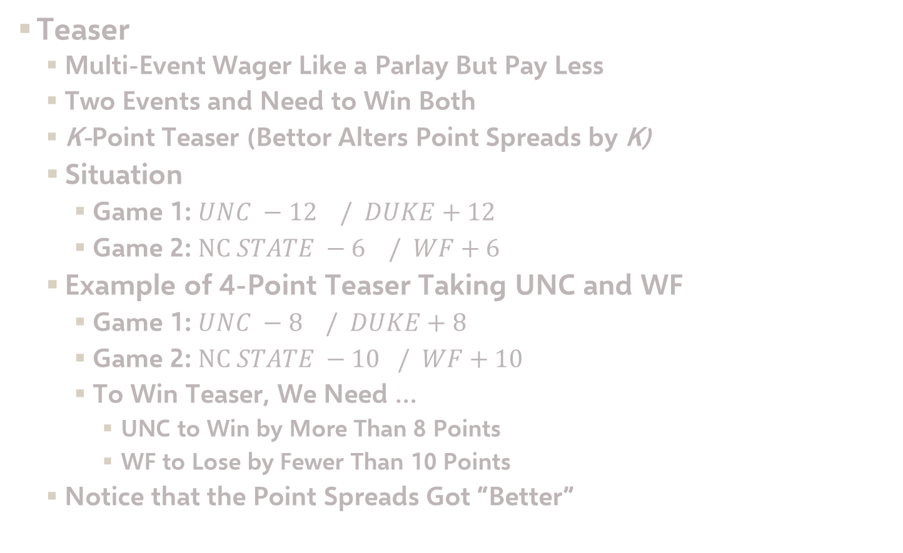
Sports gambling 101
Teaser
Multi-Event Wager Like a Parlay But Pay Less
Two Events and Need to Win Both
K-Point Teaser (Bettor Alters Point Spreads by K)
Situation
Game 1: $UNC −12 / DUKE+12$
Game 2: $NC STATE −6 / WF+6$
Example of 4-Point Teaser Taking UNC and WF
Game 1: $UNC −8 / DUKE+8$
Game 2: $NC STATE −10 / WF+10$
To Win Teaser, We Need …
UNC to Win by More Than 8 Points
WF to Lose by Fewer Than 10 Points
Notice that the Point Spreads Got “Better”

Slide 16
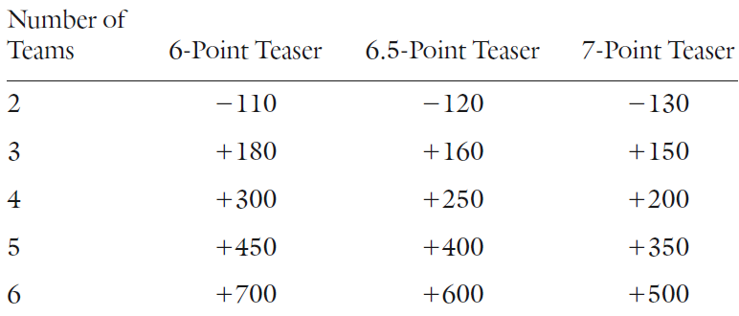
Sports gambling 101
Teaser
Either Game “Pushes” = Teaser “Pushes
In Football, Teasers Usually Involve 6, 6.5, or 7 Points
Typical Teaser Payoff Grid
History of 7-Point Teasers
Win 70.6% of the Time
Push 1.5% of the Time
Lose 27.9% of the Time
Bet $130 to Win $100
Bet $100 to Win $500

Slide 17
Sports gambling 101
Teaser
Probability of Winning Teaser
Probability of Pushing Teaser
Probability of Losing Teaser
Expected Profit of 7-Point Teaser Bet of $130
$$P\left(Win\right)=0.706×0.706=0.4984$$
$$P\left(Push\right)=0.015×0.015+0.015×0.985+0.985×.015=0.0298$$
$$P(Lose)=0.279×0.279+0.279×0.721+0.721×.279=0.4802$$
$$E\left[Profit\right]=0.4984×100+0.0298×0+0.4802×\left(−130\right)=−\$12.58$$

Slide 18

Final Inspiration
The only cure for a gambling addiction is losing all your money.
-Mahatma Mario

